Slide 1
Welcome SWFL!
1ST Blockchain & Bitcoin Seminar

Slide 16
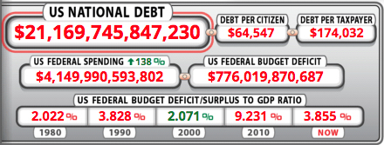

Slide 25
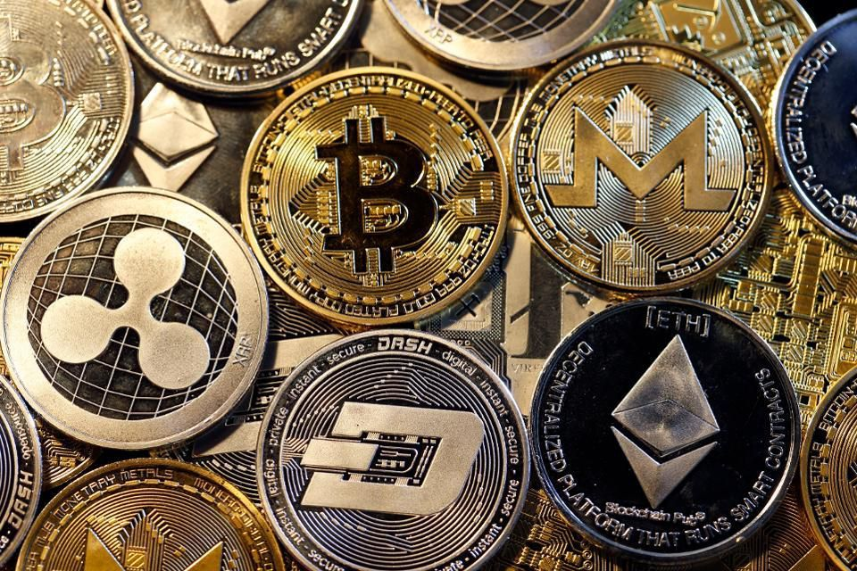
www.CIADC.co
Next Seminar December 2nd, 2018

